Slide 1
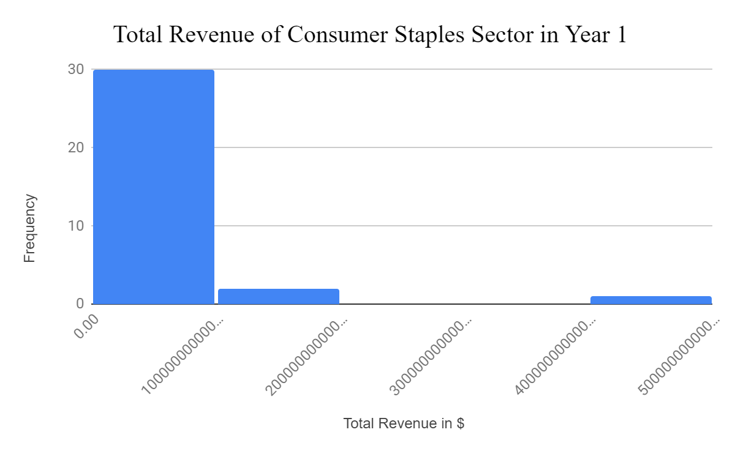
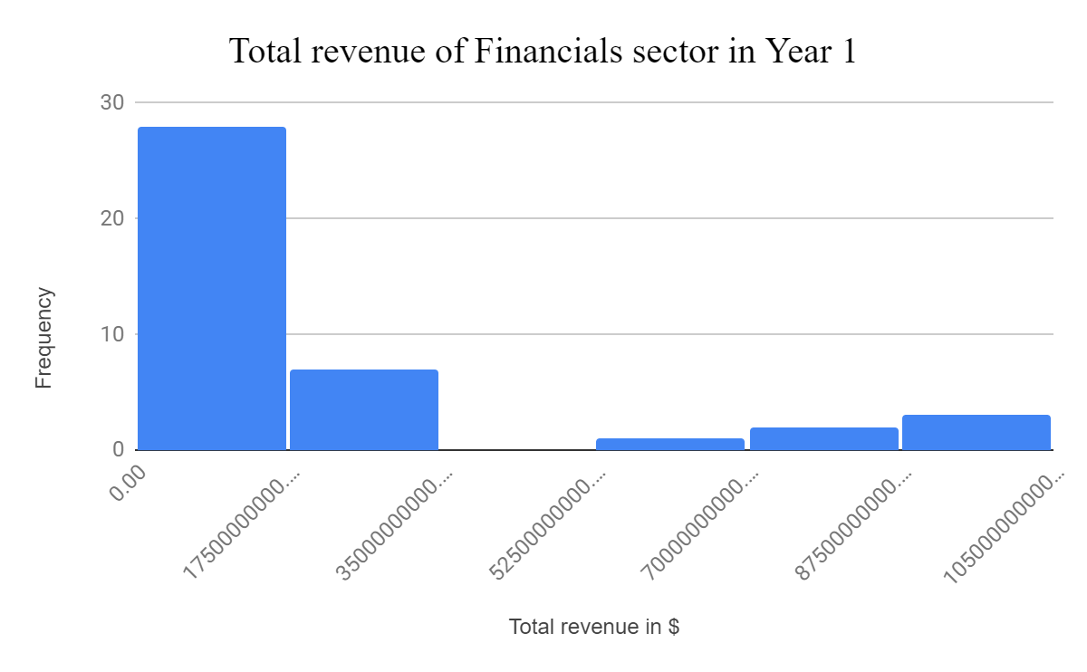
Does the Consumer staples sector have higher Average total revenue than the Financials Sector in Year 1 ?
The Histograms shows the total revenue for consumer staples and Financials sectors reported for all companies in Year 1.
From the both Histograms, we acknowledge that the Mean is higher than Median in each sector. So, the distributions are right skewed or positively skewed for both sectors.
The Mean for Consumer staples sector is $42 billion, and for Financials sector is about $21 billion. The Median is also slightly more in Consumer staples sector for about $13 billion, while the financials sector is lower for about $10 billion. The standard deviation in consumer staples sector is higher than the Financials sector for about $84 billion and $28 billion respectively. We can conclude that the Consumer staples sector have higher Average total revenue in Year 1 than Financials sector, with more companies get average of total revenue for about $42 billion. On the other hand, 50% of the Consumer staples companies gain $13 billion of total revenue in Year 1.

